Slide 1
Course Reserves
Yoel Kortick
Senior Librarian

Slide 2

Agenda
Introduction
Creating a new course
Creating a new reading list
Adding citations to the reading list
Managing Citation Fulfillment Options

Slide 3
Introduction

Slide 4
Introduction
Courses, reading lists, and citations can be managed
  Manually using the Alma user interface
  Automatically by an external service, such as Ex Libris Leganto or the Alma Web service.
This presentation describes the manual handling of these entities using Alma.
For additional information about Course Reserves in Alma see the Online Help at Courses and Reading Lists.
For information on using the Alma Web services to handle these entities, see the Courses API in the Ex Libris Developers Network.

Slide 5
Introduction
The Course Reserves components are as follows:
Courses – contain details concerning the course
Course Departments – Each course must be associated with a Course Department. A Course Department is itself associated with an organizational unit (institution or library/libraries)
Reading Lists – contain citations. A reading list is connected to a single course (if you are using Leganto, a reading list can be connected to multiple courses). A course can contain several reading lists, for example, reading lists that are processed by separate libraries.
Citations – refer to a resource, such as Alma inventory or a website. They are typically the reading list titles that must be processed (moved to and from reserved areas, digitized), or the faculty-owned copies that are part of the required reading list

Slide 6
Introduction
Course
Reading List
Reading List
Citation
Citation
Citation
Citation
Citation
Inventory
Inventory
Inventory

Slide 7
Introduction
The workflow for creating and managing a course reserves reading list is as follows (see also Courses and Reading Lists Workflow).
Create the course: Creating a course is a prerequisite to enable access to reading lists.
Create the reading list: The reading list is connected to a course and specifies resources (physical, electronic, digital) that can be selected from the repository within the library.
Add citations to the reading list
Move inventory in the reading list to the course reserves area
When course is over return items to original location.

Slide 8
Creating a new course

Slide 9
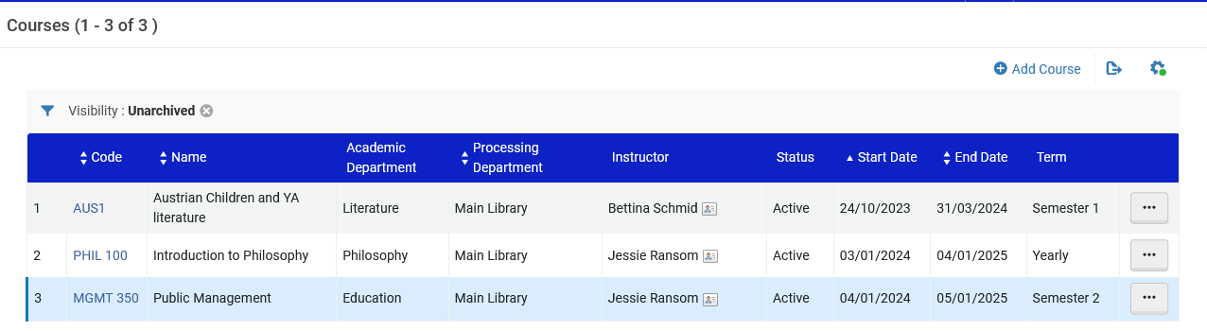
Creating a new course
Access the "Courses" page at "Fulfillment > Course Reserves > Courses"
The Course's Reading List page appears.
Click "Add Course"

Slide 10
Creating a new course
After clicking "Add Course" the "Manage Course Information" page opens with three tabs:
  Course Information
  Instructors
  Campus
For details about these tabs and the fields in each tab see the table "Manage Course Information Fields" at Managing Courses

Slide 11
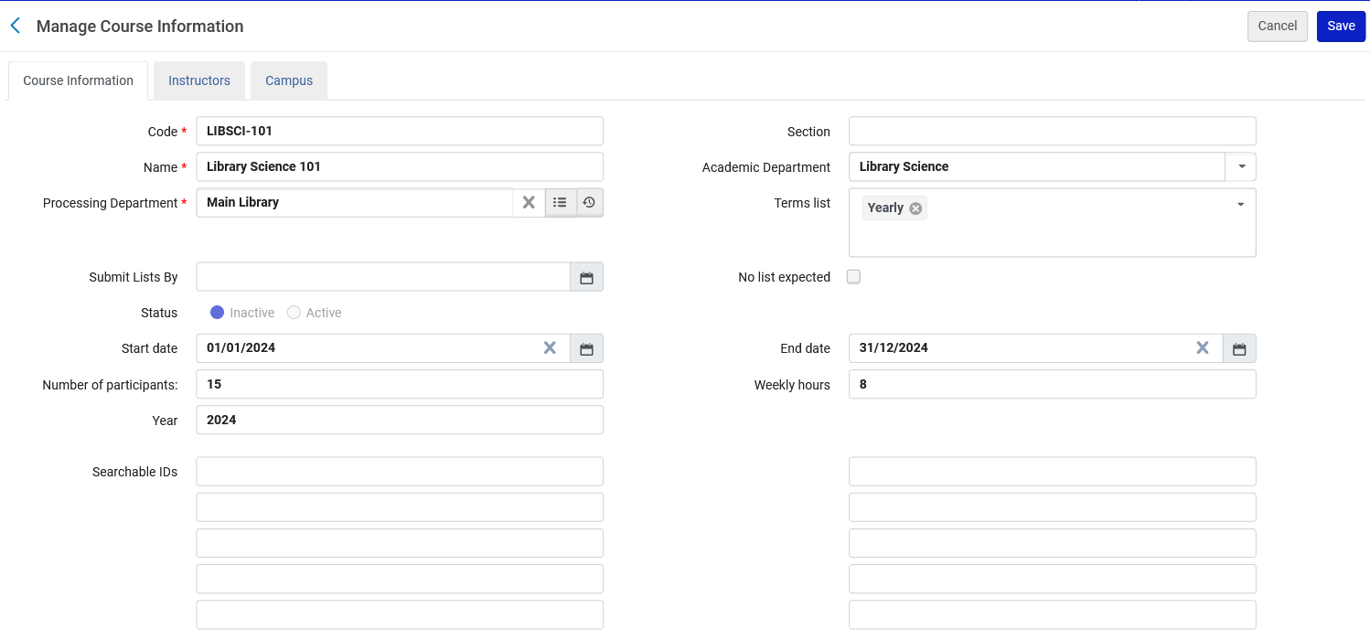
Creating a new course
Here we have created a course called "Library Science 101"

Slide 12
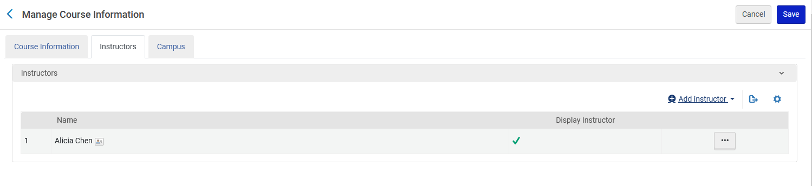
Creating a new course
This course has one instructor
Click "Save" when done

Slide 13
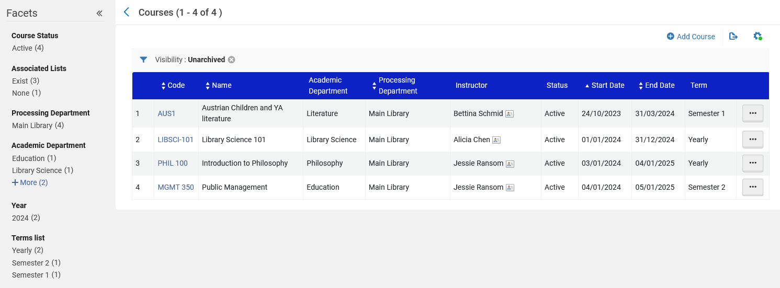
Creating a new course
After clicking "Save" the course is created.

Slide 14
Creating a new reading list

Slide 15
Creating a new reading list
Access the "Courses" page at "Fulfillment > Course Reserves > Courses"
In the row actions for the course for which you want to add a reading list select "Reading List"

Slide 16
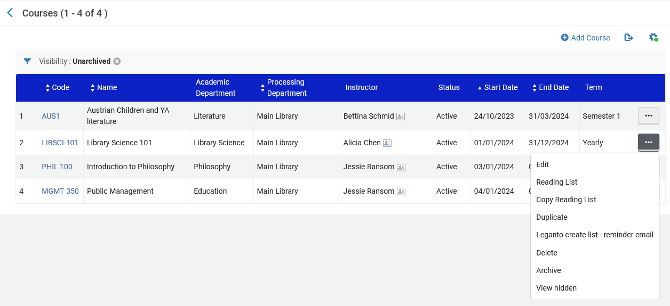
Creating a new reading list

Slide 17
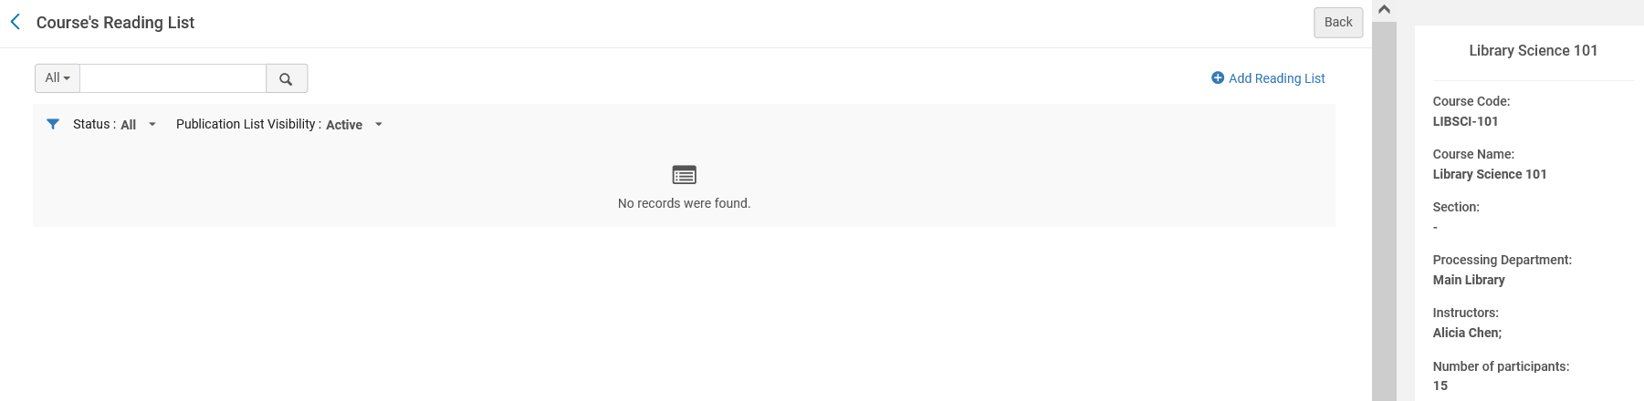
Creating a new reading list
The Course's Reading List page appears
Click "Add Reading List".

Slide 18
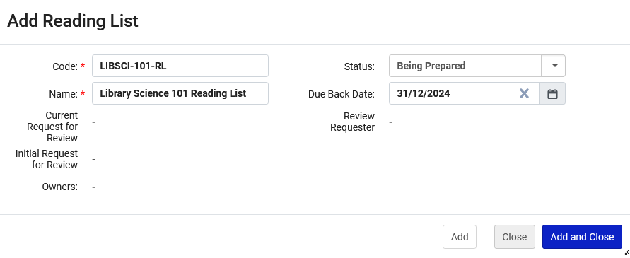
Creating a new reading list
The Add Reading List dialog box appears. We will fill in the Reading List dialog box and "Add and Close".
For a description of the fields see table "Add Reading List Fields" at Adding a Reading List
This is the date that the items which are transferred from permanent location to course reserves location are due back to permanent location. The default date is the course's end date. For details on managing a course's due back date, see Managing Reading List Due Back Dates

Slide 19
Adding citations to the reading list

Slide 20
Adding citations to the reading list
We will look at the following functions:
  Adding a Citation Already in the Repository (a repository citation).
  Adding a Citation Not in the Repository (a non-repository citation).
  Contributing Instructor Resources to a Reading List.
  Managing a Citation's Attachment to an Inventory Item.
  Managing Citation Fulfillment Options.
See also Adding Citations to a Reading List.

Slide 21
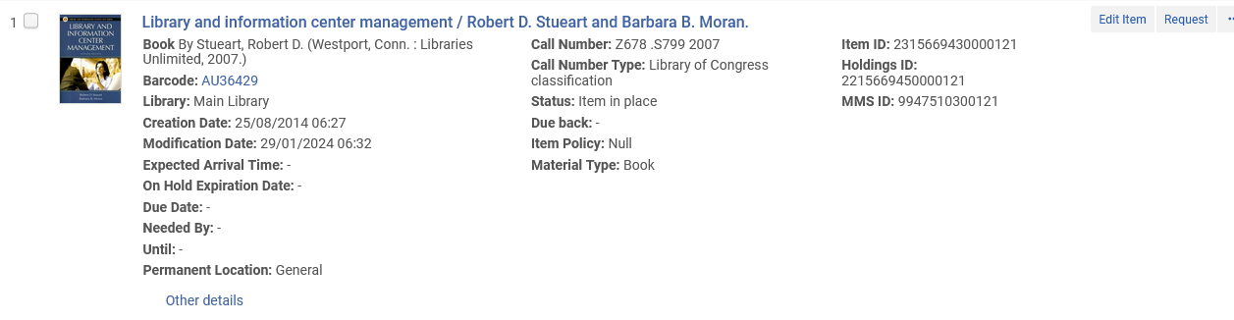
Adding citations to the reading list
We will now add a repository citation for physical title "Library and information center management / Robert D. Stueart and Barbara B. Moran".
Currently it is in place at the Main Library General Location

Slide 22
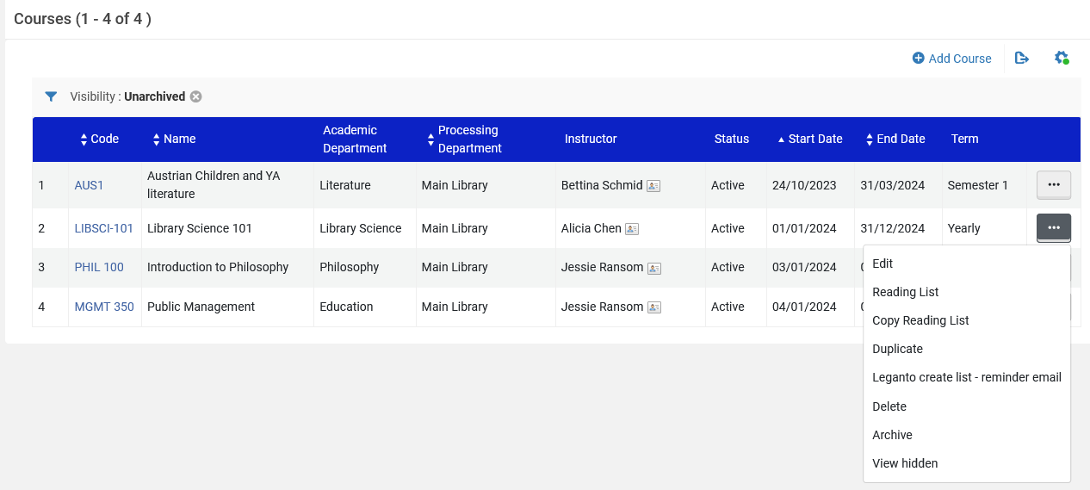
Adding citations to the reading list
From the course we will access the Reading List
Note that we could also access the Reading List via "Fulfillment > Courses > Reading Lists"

Slide 23
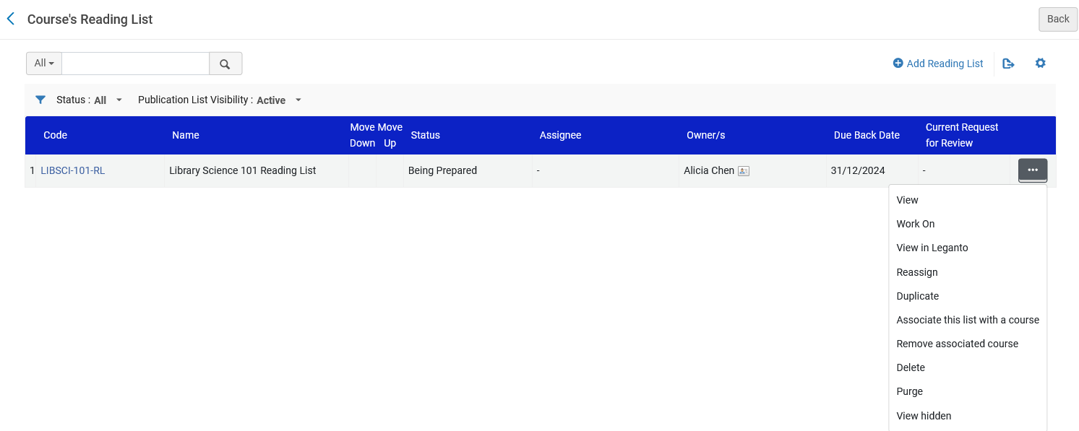
Adding citations to the reading list
Now we will "Work On" the Reading List

Slide 24
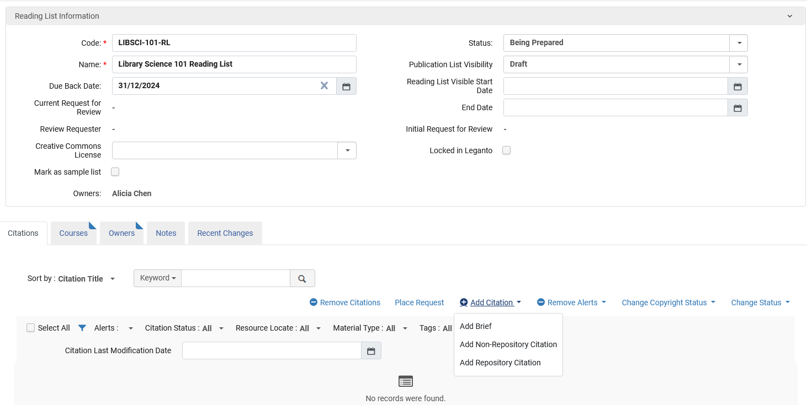
Adding citations to the reading list
Now we will choose "Add Repository Citation"

Slide 25
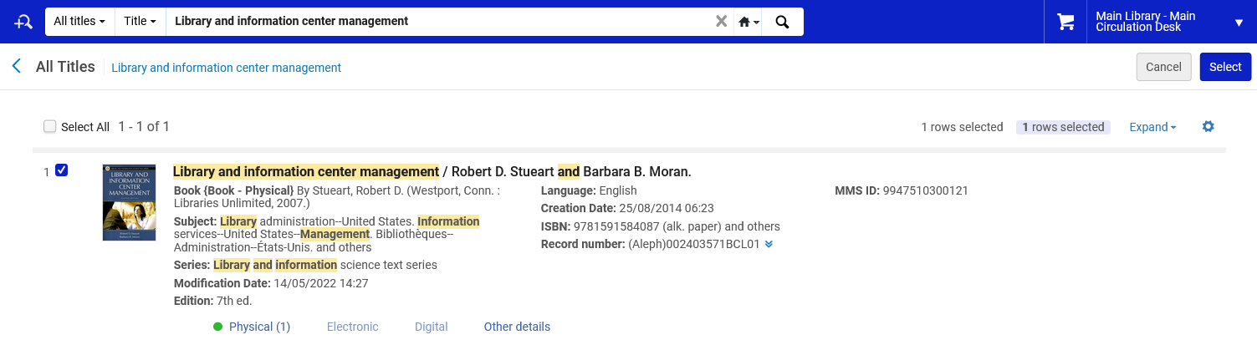
Adding citations to the reading list
We search for title and "Select".

Slide 26
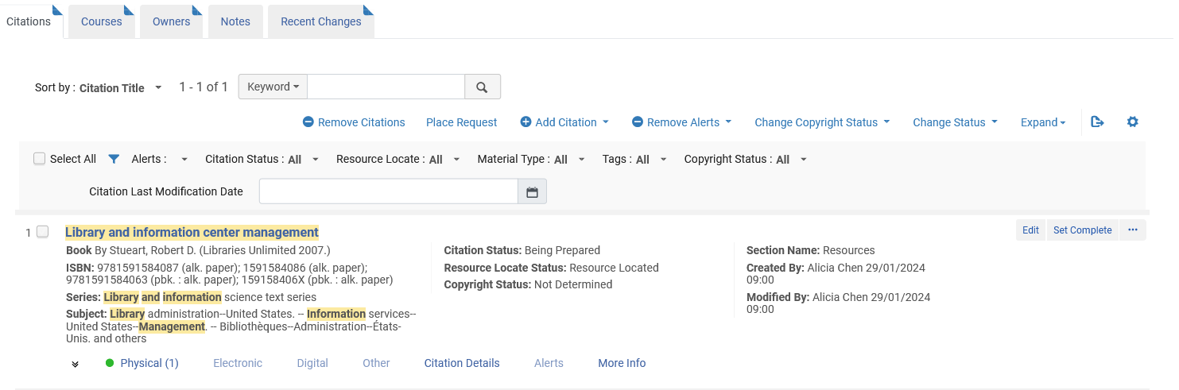
Adding citations to the reading list
The citation has been added to the Reading List

Slide 27
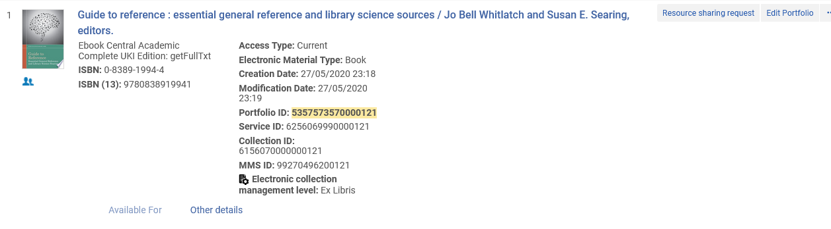
Adding citations to the reading list
We will now add a repository citation for electronic title "Guide to reference : essential general reference and library science sources".
Currently it is available from Ebook Central Academic Complete UKI Edition

Slide 28
Adding citations to the reading list
From the course we will access the Reading List
Note that we could also access the Reading List via "Fulfillment > Courses > Reading Lists"

Slide 29
Adding citations to the reading list
Now we will "Work On" the Reading List

Slide 30
Adding citations to the reading list
Now we will choose "Add Repository Citation"

Slide 31
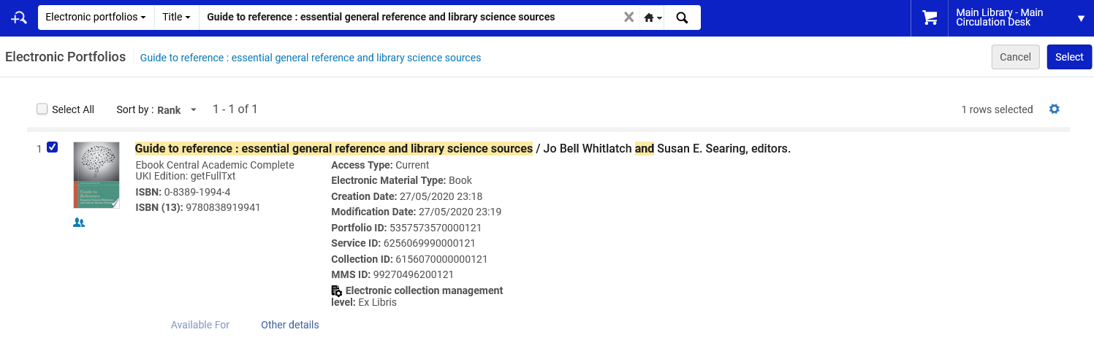
Adding citations to the reading list
We search for title and "Select".

Slide 32
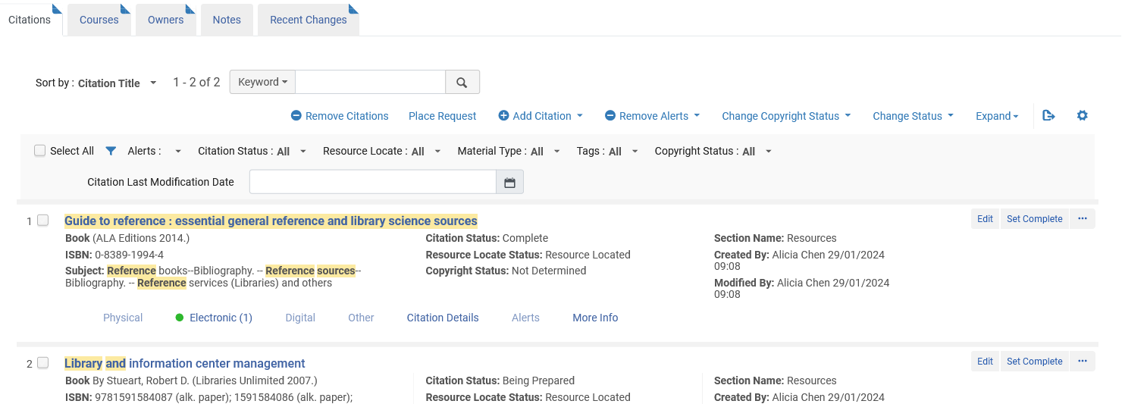
Adding citations to the reading list
The citation has been added to the Reading List

Slide 33
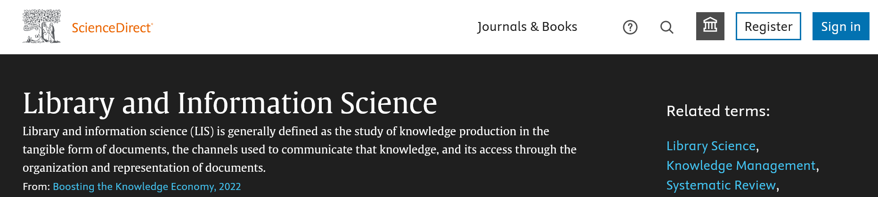
Adding citations to the reading list
We will now add a non-repository citation for a web site titled "Library and Information Science - an overview | ScienceDirect Topics".
If we were to add a non-repository citation for a physical item, we could add it to the reading list and put the physical item in the Course Reserves location.
This is the web site that we will add as a non-repository citation.

Slide 34
Adding citations to the reading list
From the course we will access the Reading List
Note that we could also access the Reading List via "Fulfillment > Courses > Reading Lists"

Slide 35
Adding citations to the reading list
Now we will "Work On" the Reading List

Slide 36
Adding citations to the reading list
Now we will choose "Add Non-Repository Citation"

Slide 37
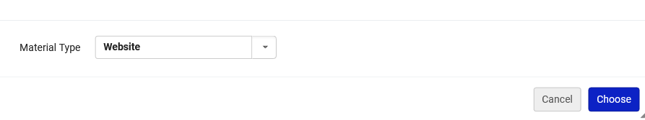
Adding citations to the reading list
Now we choose the relevant material type

Slide 38
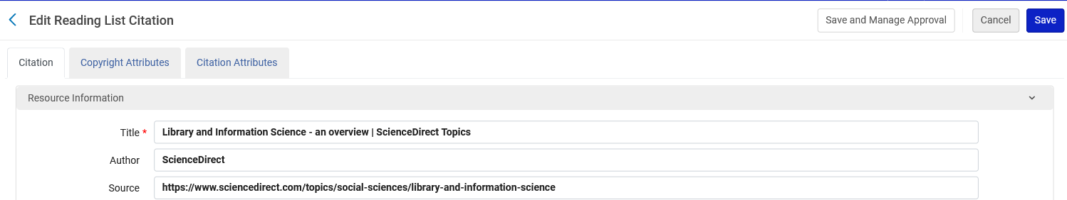
Adding citations to the reading list
We fill in details and save.

Slide 39
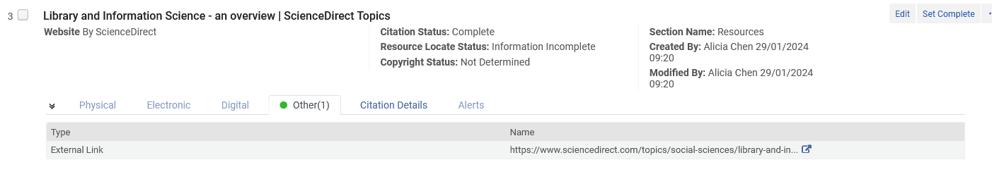
Adding citations to the reading list
The citation has been added to the Reading List with an external link to the source.

Slide 40
Adding citations to the reading list
We now have three citations in the Reading List
A physical repository citation
An electronic repository citation
An electronic non- repository citation
For the electronic resources we do not need to do anything as students will have access.
We now must manage the fulfillment options for the physical repository citation.

Slide 41
Managing Citation Fulfillment Options

Slide 42
Managing Citation Fulfillment Options
What needs to happen now is that physical items on the reading list need to move from the permanent location to be in a temporary location, typically called "Course Reserves" or "Reserves". When the course is over the items need to move back to the permanent location.
While in the temporary location the fulfillment policy of the item will be based on whatever is defined for items in that temporary location.
There are multiple ways to move the items to the temporary location, and the preferred method may differ from institution to institution.
We will show one option here.

Slide 43
Managing Citation Fulfillment Options
On the Edit Reading List page for the relevant citation select the Manage Fulfillment Options citation action.
If we want to take the item off the shelf and transfer it to the Course Reserves location, then a staff user can retrieve the items from the shelves by selecting the Print slip citation action to print a slip for the specific citation. We will use this option.
Then we will use the Change Item Information tab to temporarily change the item location, as described in Changing Item Information.
See also Managing Citation Fulfillment Options at Managing Citations.

Slide 44
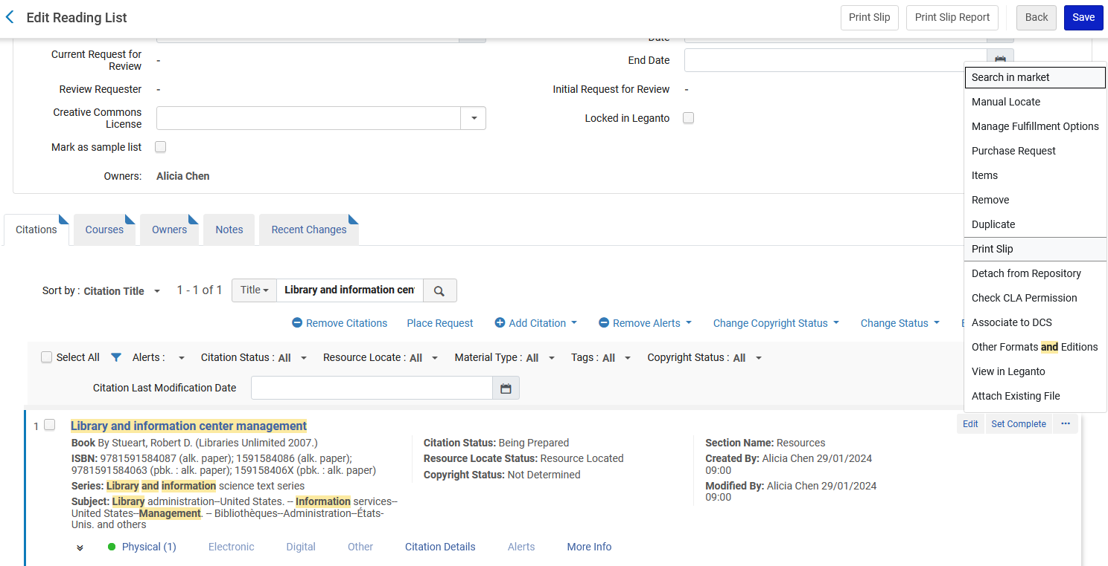
Managing Citation Fulfillment Options
Go to the "Citations" tab of the reading list
Search for the citation
Selected "Manage Fulfillment Options" for the specific citation

Slide 45
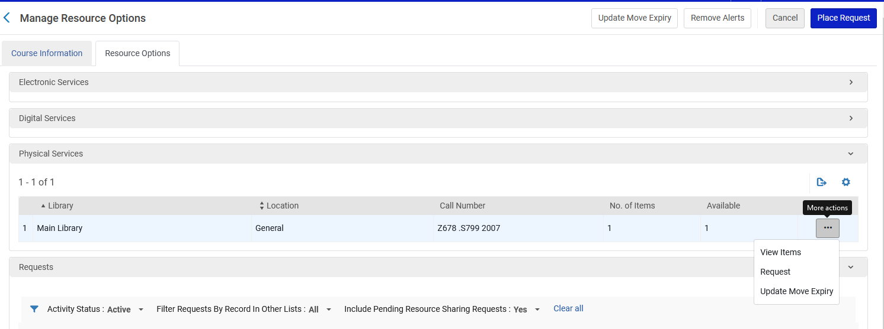
Managing Citation Fulfillment Options
We will place a request on the physical item of the citation

Slide 46
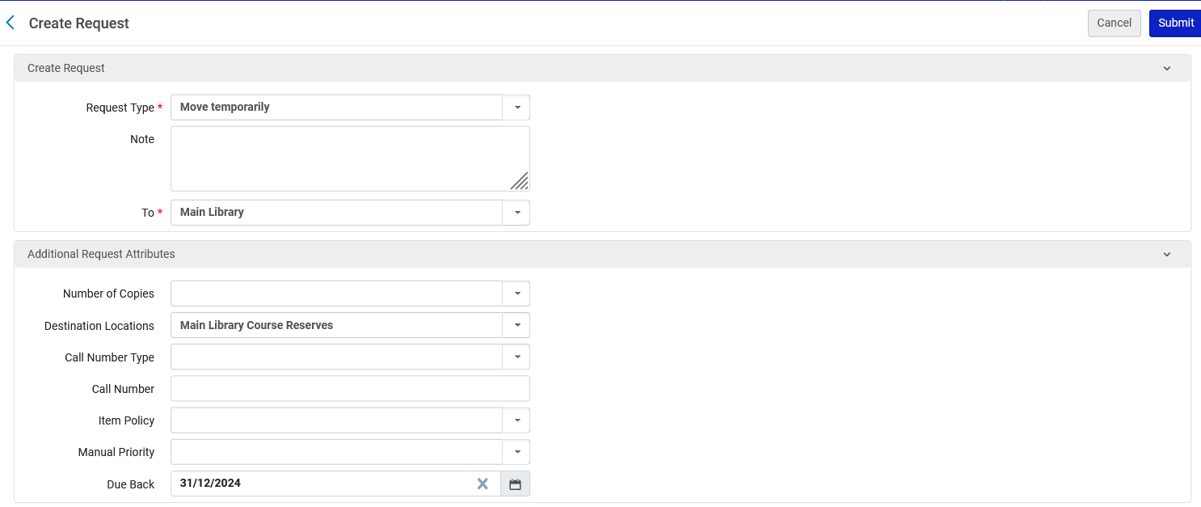
Managing Citation Fulfillment Options
The request will be to move temporarily to the Course Reserves location
The request will be to move temporarily to the Course Reserves location
The "Request Type" is "Move temporarily"
Move to a specific "Course Reserves" location
The request automatically gets a due back date which is the end of the course

Slide 47
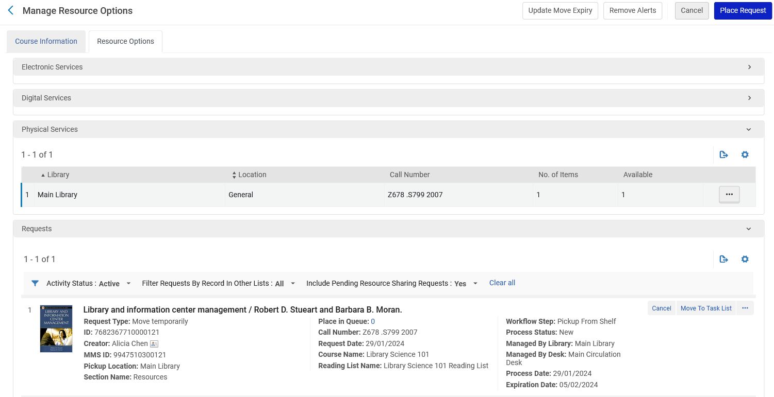
Managing Citation Fulfillment Options
The request has been made

Slide 48
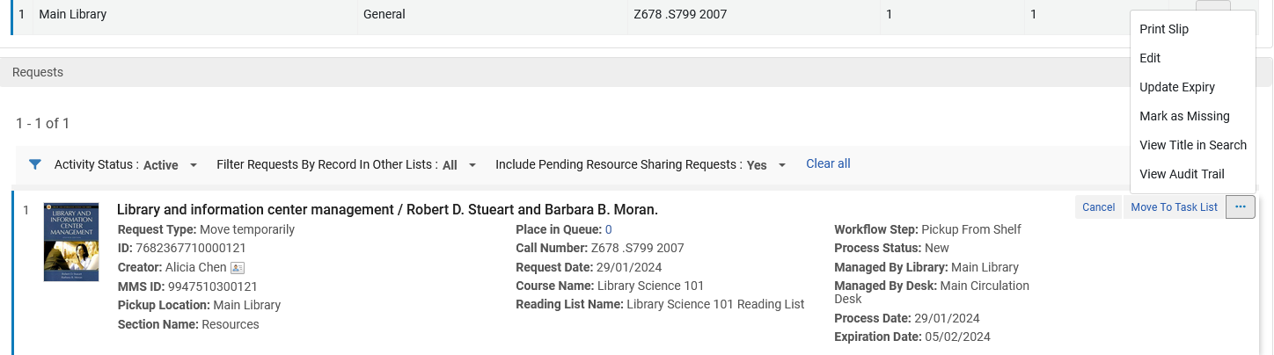
Managing Citation Fulfillment Options
If desired, we can print a slip to aid a staff user getting it from the shelf

Slide 49
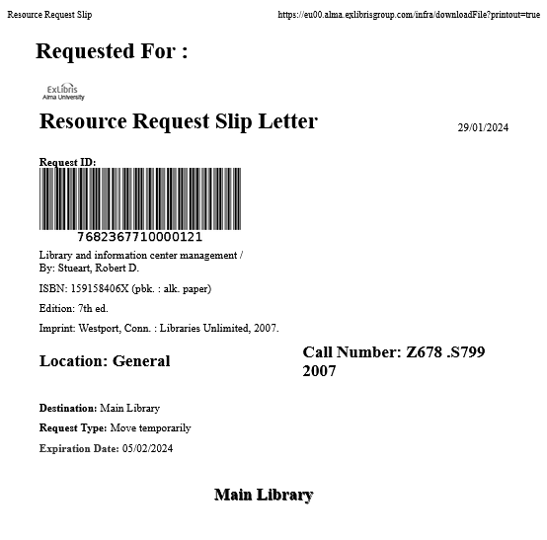
Managing Citation Fulfillment Options
The slip is printed

Slide 50
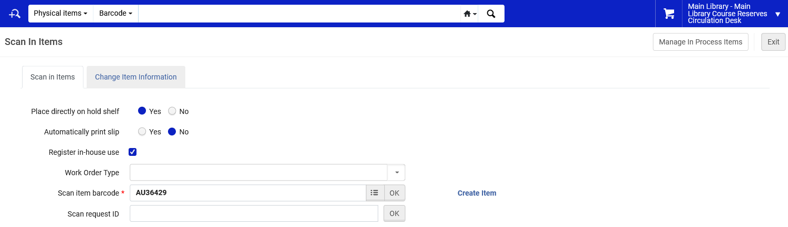
Managing Citation Fulfillment Options
At the Course Reserves circulation desk, we will scan in the item to fulfill the request of type "Move Temporarily"

Slide 51
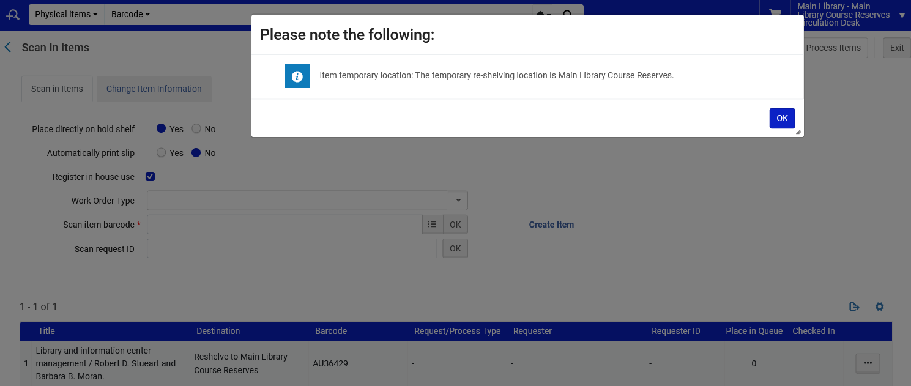
Managing Citation Fulfillment Options
The item moves to the temporary Course Reserves location

Slide 52
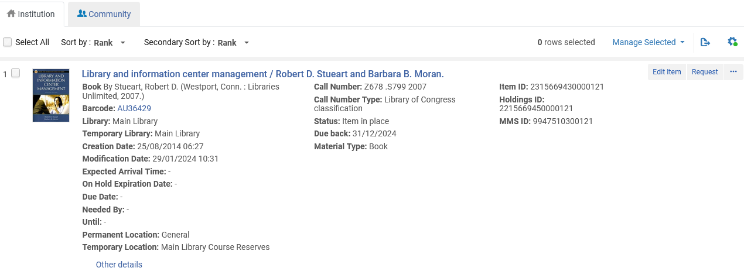
Managing Citation Fulfillment Options
The item is now temporarily in the Course Reserves location with a due back date of 31/12/2024 (we already saw that the move request automatically gets a due back date which is the end of the course.

Slide 53
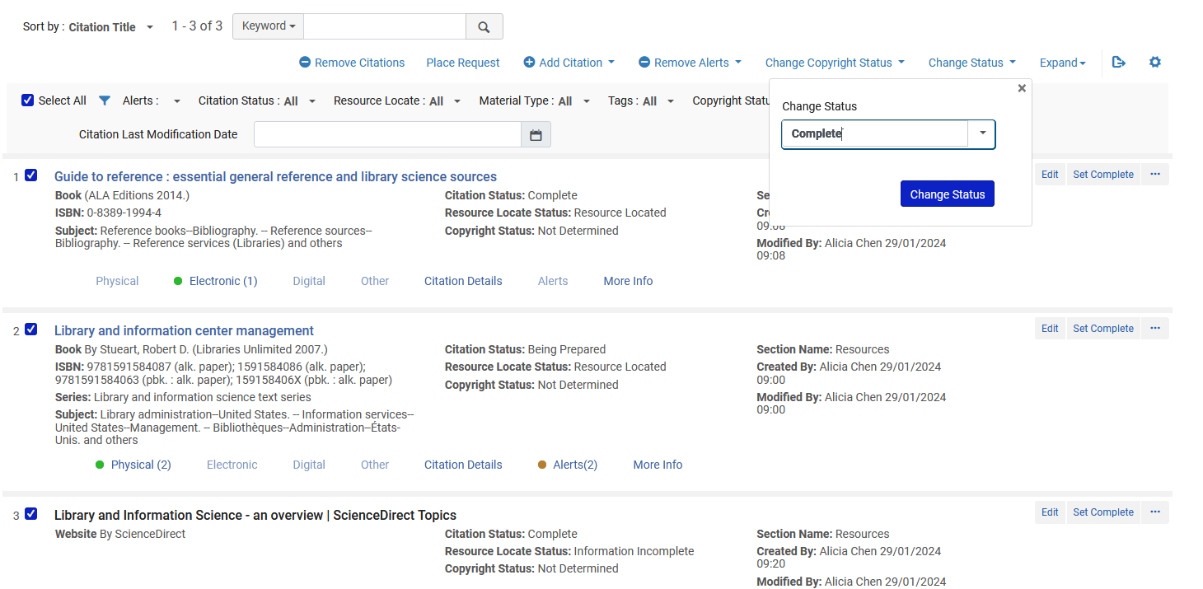
Managing Citation Fulfillment Options
We can meanwhile change all three citations to "Complete"

Slide 54
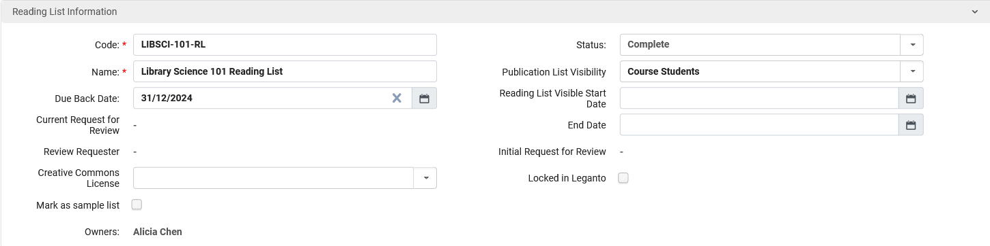
Managing Citation Fulfillment Options
And the Reading List status has changed to "Complete"

Slide 55
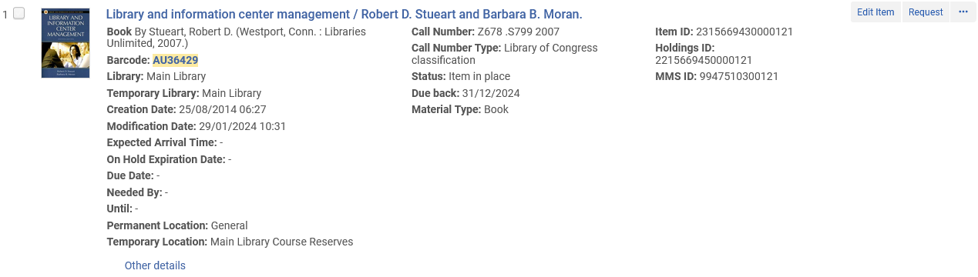
Managing Citation Fulfillment Options
The item is now at the Course Reserves location with a Due Back Date of 31/12/2024.

Slide 56
Managing Citation Fulfillment Options
On the Due Back Date of 31/12/2024 a transfer request will automatically be created for the item to transfer back to the permanent location.
This is done via the job "Requests - Restore Temporarily Shelved Items" which runs as defined at "Fulfillment > General > Fulfillment Jobs Configuration".
When the request is made it will appear in the "Pick from shelf list"
Definition of the job the job "Requests - Restore Temporarily Shelved Items" defined at "Fulfillment > General > Fulfillment Jobs Configuration".

Slide 57
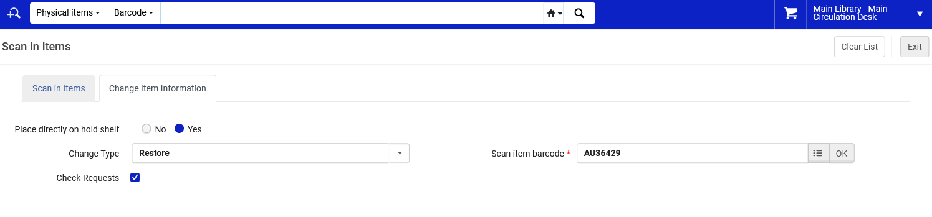
Managing Citation Fulfillment Options
The item can also be restored to the permanent location by scanning it in at a desk associated with the permanent location and switching to the "Change Item Information" tab and choosing "Change Type" "Restore".

Slide 58
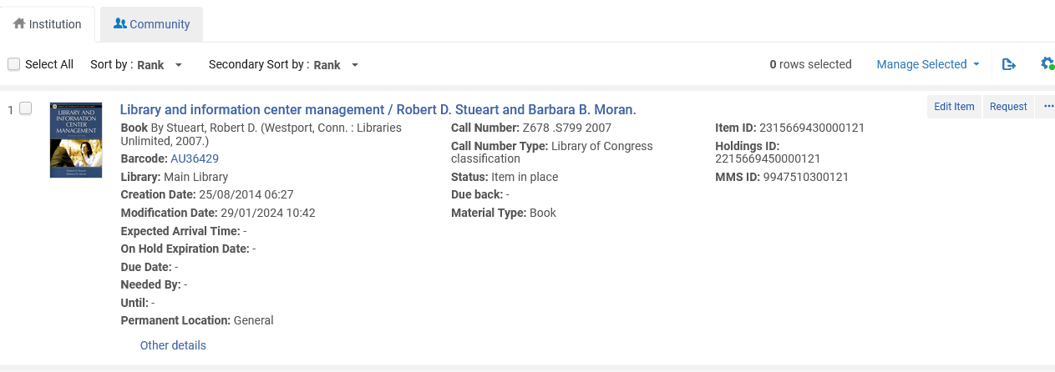
Managing Citation Fulfillment Options
The item is back in the permanent location (when the course is complete)

